Slide 1
01/07
AI BOOTCAMP PROJECT
PRIVATE
LLM
Running AI locally—
from laptop setup to
Android success.
MY PROCESS
A practical test of private, on-device AI using Bionic and Private AI.
AZUKA JENNIFER ETUE • PRIVATE LLM
Notes:
[Sources]
- User-provided screenshots, 15 August 2026.

Slide 2
02/07
THE TOOLS
Two apps. One goal.
Run an AI model locally instead of relying only on a public cloud chatbot.
BIONIC
Windows laptop
Model tested: Gemma 3 1B
PRIVATE AI
Android phone
Model used: LFM2.5 350M
The smaller phone model became the practical solution.
AZUKA JENNIFER ETUE • PRIVATE LLM
Notes:
[Sources]
- User-provided screenshots, 15 August 2026.

Slide 3
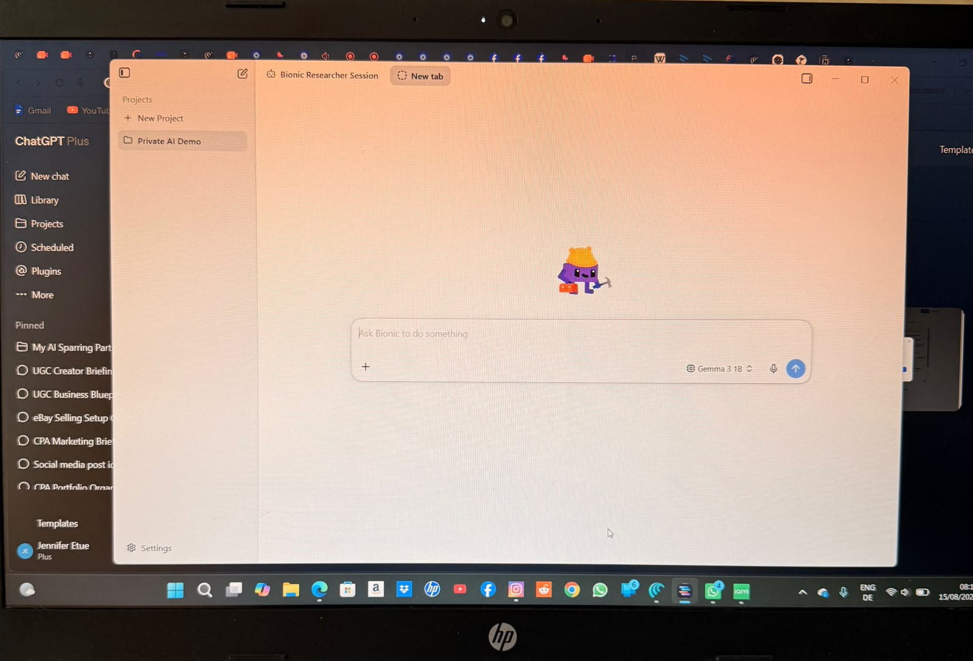
03/07
LAPTOP SETUP
I started on my Windows laptop.
I created a Private AI Demo project in Bionic and selected the Gemma 3 1B model.
Bionic • Private AI Demo • Gemma 3 1B
AZUKA JENNIFER ETUE • PRIVATE LLM
Notes:
[Sources]
- User-provided screenshots, 15 August 2026.

Slide 4
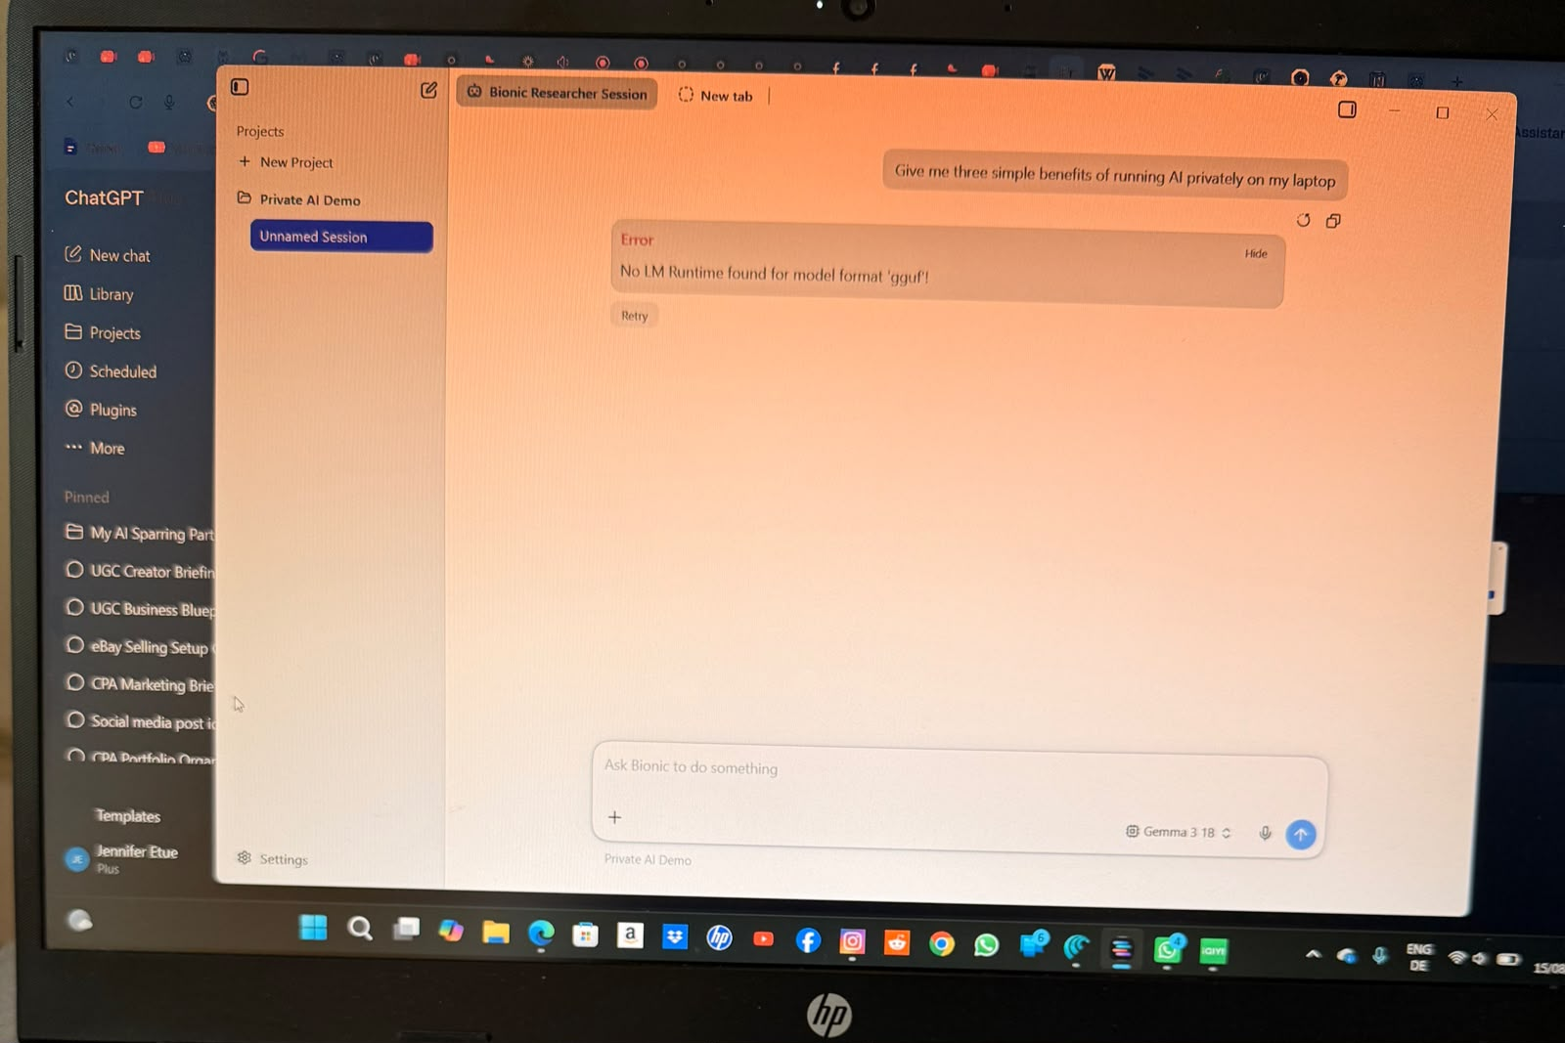
04/07
WHAT HAPPENED
The model could not run on the laptop.
Bionic returned a runtime error when I sent the prompt.
“No LM Runtime found for model format ‘gguf’.”
AZUKA JENNIFER ETUE • PRIVATE LLM
Notes:
[Sources]
- User-provided screenshots, 15 August 2026.

Slide 5
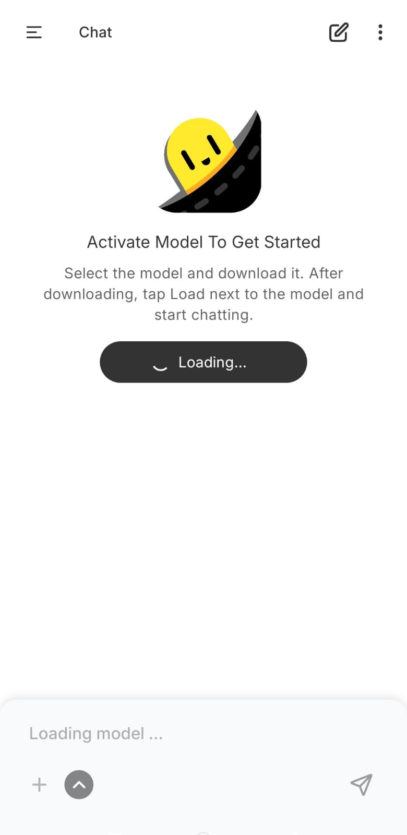
05/07
ANDROID SETUP
I continued the test on Android.
I downloaded and loaded a smaller model that could run on the phone.
Private AI • Loading the local model
AZUKA JENNIFER ETUE • PRIVATE LLM
Notes:
[Sources]
- User-provided screenshots, 15 August 2026.

Slide 6
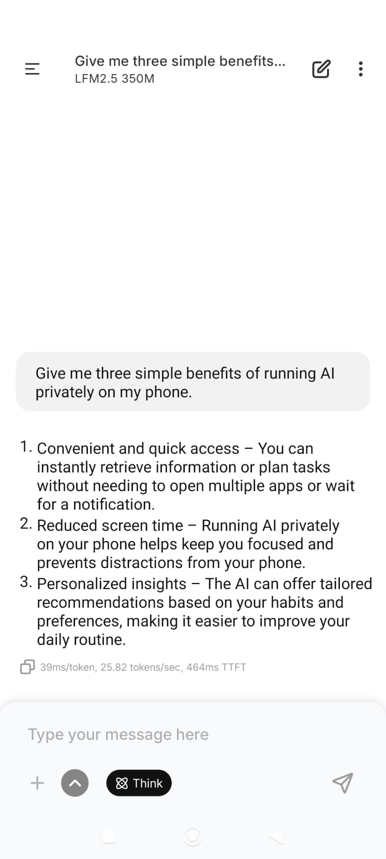
06/07
SUCCESSFUL TEST
The Private LLM responded on my phone.
I asked for three benefits of running AI privately. The LFM2.5 350M model generated a full response.
Prompt sent ✓ Local response generated ✓
AZUKA JENNIFER ETUE • PRIVATE LLM
Notes:
[Sources]
- User-provided screenshots, 15 August 2026.

Slide 7
07/07
WHAT I LEARNED
Private AI must fit the device.
The right model is not simply the largest one—it is the one the available hardware can run reliably.
01
PRIVACY
Local models can process prompts on the device.
02
COMPATIBILITY
The model format and runtime must work together.
03
PRACTICALITY
A smaller model can be the better real-world choice.
RESULT: PRIVATE LLM TEST COMPLETED ON ANDROID
AZUKA JENNIFER ETUE • PRIVATE LLM
Notes:
[Sources]
- User-provided screenshots, 15 August 2026.

